Slide 1

Introduction
5
CS/COE 0449 Introduction to Systems Software
to Memory
wilkie
(with content borrowed from Vinicius Petrucci and Jarrett Billingsley)
Spring 2019/2020

Slide 2
The Memory Model
If you forget how addressing works, I have a few pointers for you.

Slide 3
The C Memory Model
Potential Layout
(32-bit addresses)
Memory is a continuous series of bits.
It can be logically divided into bytes or words.
We will treat it as byte-addressable which means individual bytes can be read.
This is not always the case!!
Consider masking and shifting to know the workaround!
With byte-addressable memory, each and every byte (8 bits) has its own unique address.
It’s the place it lives!! Memory is JUST LIKE US!
Address starts at 0, second byte is at address 1, and increases (“upward”) as you add new data.
~ 0xFFFFFFFF
stack
currently unused but
available memory
heap
static data
code
~ 0x00000000

Slide 4
The C Memory Model
Potential Layout
(32-bit addresses)
There are two main parts of a program: code and data
“code” is sometimes called “text”
Where in memory should each go?
Should we interleave them?
Which do you think is usually largest?
How do we use memory dynamically?
That is, only when we know we need it, in the moment.
~ 0xFFFFFFFF
stack
currently unused but
available memory
heap
static data
code
~ 0x00000000

Slide 5
The C Memory Model: Code
Potential Layout
(32-bit addresses)
Code has a few known properties:
It likely should not change.
It must be loaded before a program can start.
~ 0xFFFFFFFF
stack
int my_static_var = 1;
int factorial(int n) {
if (n <= 1) { return my_static_var; }
return n * factorial(n - 1);
}
void main(void) {
factorial(5);
}
currently unused but
available memory
heap
static data
code
~ 0x00000000

Slide 6
The C Memory Model: Static Data
Potential Layout
(32-bit addresses)
Static Data is an oft forgotten but useful section.
It does change. (contrary to its name)
It generally must be loaded before a program starts.
The size of the data and section is fixed.
~ 0xFFFFFFFF
stack
int my_static_var = 1;
int factorial(int n) {
if (n <= 1) { return my_static_var; }
return n * factorial(n - 1);
}
void main(void) {
factorial(5);
}
currently unused but
available memory
heap
static data
code
~ 0x00000000

Slide 7
The C Memory Model: The Stack
Potential Layout
(32-bit addresses)
The Stack is a space for temporary dynamic data.
Holds local variables and function arguments.
Allocated when functions are called. Freed on return.
Grows “downward”! (Allocates lower addresses)
~ 0xFFFFFFFF
stack
int my_static_var = 1;
int factorial(int n) {
if (n <= 1) { return my_static_var; }
return n * factorial(n - 1);
}
void main(void) {
factorial(5);
}
currently unused but
available memory
heap
static data
Stack Allocation allows recursion. However, the more you recurse, the more you use! (Stack is only freed on return)
code
~ 0x00000000

Slide 8

Revisiting our past troubles:
#include <stdio.h> // Gives us 'printf'
#include <stdlib.h> // Gives us 'rand' which returns a random-ish int
void undefined_local() {
int x;
printf("x = %d\n", x);
}
void some_calc(int a) {
a = a % 2 ? rand() : -a;
}
int main(void) {
for (int i = 0; i < 5; i++) {
some_calc(i * i);
undefined_local();
}
return 0;
}
SERIOUS
4. Stack Allocation (No initialization!)
It reuses what is already there!!
Output:
x = 0
x = 1804289383
x = -4
x = 846930886
x = -16
2. Stack Allocation
1. Function Call
3. Function Call
Q: Hmm. Where is the value for ‘x’ coming from? Why?

Slide 9
The C Memory Model: The Heap
Potential Layout
(32-bit addresses)
The Heap is the dynamic data section!
Managing this memory can be very complex.
No garbage collection provided!!
We will revisit it in greater detail very soon.
~ 0xFFFFFFFF
stack
#include <stdlib.h> // For 'malloc'
void main(void) {
// I want 10 integers in my array.
// malloc returns the address in the
// heap. But, wait, what’s that * ??
int* data = malloc(sizeof(int) * 10);
}
currently unused but
available memory
heap
static data
code
~ 0x00000000

Slide 10
Pointers
They point to things. They are not the things.

Slide 11
The “Memory Address” Variable Type
In C, we have integer types, floating point types…
Now we introduce our dedicated address type!
A pointer is a specific variable type that holds a memory address.
You can create a pointer that points to any address in memory.
Furthermore, you can tell it what type of data it should interpret that memory to be: Just place that * at the end.
int* my_integer_somewhere;
float* hey_its_a_float;
struct Song* ah_our_trusty_song_type;

Slide 12
Interpreting Pointers: Basics
Memory
(32-bit addresses)
int* my_int
= 0x20000000;
float* my_float
= 0xB804524C;
~ 0xFFFFFFFF
0xB804524C
3.14159
0x20000000
42
Pointers can pointer to individual sections of memory.
They interpret whatever binary information is there.
~ 0x00000000

Slide 13
Interpreting Pointers: Hmm
Memory
(32-bit addresses)
int* my_int
= 0x20000000;
float* my_float
= 0x20000000;
~ 0xFFFFFFFF
0xB804524C
3.14159
0x20000000
42 or 0.1543e10(-8) ?
Pointers can refer to the same address as other pointers just fine.
They interpret whatever binary information is there.
~ 0x00000000

Slide 14
Interpreting Pointers: A Sign of Trouble
Memory
(32-bit addresses)
int* my_int
= 0x20000000;
float* my_float
= 0x20000000;
~ 0xFFFFFFFF
☹
Help I’m Lost!
3.14159
0x20000000
42 or 0.1543e10(-8) ?
Without the pointer, allocated data may linger forever without a way to reference it again!
C does not manage freeing memory for you.
~ 0x00000000

Slide 15
Dereferencing Pointers: A Star is Born
So, we have some ambiguity in our language.
If we have a variable that holds an address, normal operations change the address not the value referenced by the pointer.
We use the dereference operator ( * )
int* dataptr = 0x00800000; // this address is arbitrary
dataptr = 0xffffffff; // Reassigns the ADDRESS
*dataptr = 42; // Reassigns the VALUE
int data = 0xc0de; // Initializes a new variable
data = *dataptr; // Assigns VALUE from pointer

Slide 16
Dereferencing Pointers: A Star is Born
Remember: C implicitly coerces whatever values you throw at it…
Incorrectly assigning a value to an address or vice versa will be…
… Well … It will be surprising to say the least.
Generally, compilers will issue a warning.
But warnings mean it still compiles!! (You should eliminate warnings in practice)
int* dataptr = 0x00800000; // this address is arbitrary
int* secondptr = dataptr; // Assigns ADDRESS
int* thirdptr = *dataptr; // VALUE casted to ADDRESS?
example.c:4:17: warning: initialization of 'int *' from 'int' makes pointer from integer without a cast

Slide 17
Referencing Data: An… &… is Born?
Again… ambiguity. When do you want the address or the data?
We can pull out the address to data and assign that to a pointer.
Sometimes we refer to pointers as ‘references’ to data.
We use the reference operator ( & )
int* dataptr = 0x00800000; // this address is arbitrary
int data = 0xc0de; // Initializes a new variable
dataptr = &data; // Assigns ADDRESS to pointer
*dataptr = 42; // Assigns 42 to memory!
printf("%d\n", data); // Prints 42!
reference!
dereference!

Slide 18

Turtles all the way down
int data = 42;
int* dataptr = &data; // store address of data
// pointer to a pointer of an int:
int** dataptrptr = &dataptr; // store address of dataptr
// dereference dataptrptr... then dereference that...
*(*dataptrptr) = -64; // store VALUE into 'data'

Slide 19
Like skipping rocks on the lake…
int data = 42; // Initializes a new variable
int* dataptr = &data; // Assigns ADDRESS to pointer
printf("%d\n", data); // Prints 42!
printf("%d\n", *dataptr); // Prints 42!
printf("%p\n", dataptr); // Prints the ADDRESS of data
// However, 'data' could be ANYWHERE
&
00 | 01 | 02 | 03 | 04 | 05 | 06 | 07 | 08 | 09 | 0A | 0B | 0C | 0D | 0E | 0F | 10 | 11 | 12 | 13
42
4
data
dataptr
*

Slide 20
Like skipping rocks on the lake…
int data = 42; // Initializes a new variable
int* dataptr = &data; // Assigns ADDRESS to pointer
int** dataptrptr = &dataptr;
printf("%p\n", dataptr);
printf("%p\n", dataptrptr);
printf("%d\n", **dataptrptr); // Prints "42"!
&
&
00 | 01 | 02 | 03 | 04 | 05 | 06 | 07 | 08 | 09 | 0A | 0B | 0C | 0D | 0E | 0F | 10 | 11 | 12 | 13
42
4
A
data
dataptr
dataptrptr
*
*

Slide 21
The C Memory Model: The Heap
Potential Layout
(32-bit addresses)
The Heap is the dynamic data section!
You interact with the heap entirely with pointers.
malloc returns the address to the heap with at least the number of bytes requested. Or NULL on error.
~ 0xFFFFFFFF
stack
#include <stdlib.h> // For 'malloc'
void main(void) {
// I want 10 integers in my array.
// malloc returns the address in the
// heap. WAIT, that’s an array??!?
int* data = malloc(sizeof(int) * 10);
}
currently unused but
available memory
heap
static data
code
~ 0x00000000

Slide 22
Arrays
It is what all my fellow teachers desperately need: Arrays.
(Support your local teacher’s union)

Slide 23
Many ducks lined up in a row
An array is simply a continuous span of memory.
You can declare an array on the stack:
You can declare an array on the heap:
void main(void) {
int array[5]; // 5 integers... with garbage in them
}
void main(void) {
// 5 integers... with garbage in them
int* array = (int*)malloc(sizeof(int) * 5);
}
writing in a pedantic style, you would write the cast here.

Slide 24
Initialization
You can initialize them depending on how they are allocated:
You can initialize an array as it is allocated on the stack:
And the heap (for values other than 0, you’ll need a loop):
void main(void) { // Unspecified values default to 0:
int array[5] = {1, 42, -3}; // [1, 42, -3, 0, 0]
}
void main(void) {
// 5 integers... 'calloc' sets the memory to 0.
int* array = (int*)calloc(5, sizeof(int));
}
Q: Why is using sizeof important here?

Slide 25
Carelessness means the Stack; Can stab you in the back!
— “A poem about betrayal” by wilkie
Remember: Variables declared on the stack are temporary.
All arrays can be considered pointers, but addresses to the stack are not reliable:
This may work sometimes.
However calling a new function will overwrite the array. Don’t trust it!!
Instead: Allocate on the heap and pass in a buffer. (next slide)
int* powers_of_two(void) {
int array[5] = {1, 2, 4, 8, 16};
return array;
}
Stack allocation
Arrays are indeed just pointers! This is an address on the stack.
Stack deallocation (oh no!)

Slide 26
Appropriate use of arrays. Approp-array-te.
#include <stddef.h> // For 'size_t'
#include <stdlib.h> // For 'malloc', 'calloc', and 'free'
#include <stdio.h> // For 'printf'
void powers_of_two(int* buffer, size_t length) {
int value = 1;
for (int i = 0; i < length; i++) {
buffer[i] = value;
value *= 2;
}
}
void main(void) {
int* buffer = calloc(10, sizeof(int));
powers_of_two(buffer, 10);
for (int i = 0; i < 10; i++) {
printf("%d\n", buffer[i]);
}
free(buffer); // Make sure you free any memory you use!
}
Arrays don’t store length. Gotta pass it in.
Pointers allow for passing arguments “by reference”
Pointers can indeed be array-like!
Heap allocation! Although we overwrite all values, using calloc to initialize array elements to 0 reduces surprises.
Q: What happens if we pass 20 instead of 10 to powers_of_two?

Slide 27
Quick notes on function arguments, here…
All arguments are passed “by value” in C.
This means the values are copied into temporary space (the stack, usually) when the functions are called.
This means changing those values does not change their original sources.
However, we can pass “by reference” indirectly using pointers:
Similar to how you pass “by reference” in Java by using arrays.
void powers_of_two(int* buffer, size_t length) {
int value = 1;
for (int i = 0; i < length; i++) {
buffer[i] = value; // Changes the value in the array.
value *= 2;
}
}
The “value” of the argument is the address.

Slide 28
Careful! No guard rails… You might run off the edge…
Since arrays are just pointers… and the length is not known…
Accessing any element is correct regardless of actual intended length!
No array bounds checking is the source of many very serious bugs!
Can pull out and leak arbitrary memory.
Can potentially cause the program to execute arbitrarily code.
What if this is too big?
void powers_of_two(int* buffer, size_t length) {
int value = 1;
for (int i = 0; i <= length; i++) {
buffer[i] = value; // Does exactly what you say.
value *= 2;
}
}
A simple mistake, but it will gleefully write to it!

Slide 29
Pointer arithmetic (Warning: it’s wacky)
Because pointers and arrays are essentially the same concept in C…
Pointers have some strange interactions with math operations.
Ideally pointers should “align” to their values in memory.
Goal: Incrementing an int pointer should go to the next int in memory.
That is, not part way between two int values.
Therefore, pointer sum is scaled to the element size.
Multiplication and other operators are undefined and result in a compiler error.
int* ptr = (int*)0x400; // Arbitrary for illustration
ptr++; // ptr is 0x404 (assuming 32-bit int)
ptr *= 2; // Error: multiplication not valid!

Slide 30
Pointer arithmetic in practice:
#include <stddef.h> // For 'size_t'
#include <stdlib.h> // For 'malloc', 'calloc', and 'free'
#include <stdio.h>
void powers_of_two(int buffer[], size_t length) {
int value = 1;
for (int i = 0; i < length; i++) {
*buffer++ = value; // Assigns and then moves the pointer to the next item.
value *= 2;
}
}
void main(void) {
int* buffer = calloc(10, sizeof(int));
powers_of_two(buffer, 10);
for (int i = 0; i < 10; i++) {
printf("%d\n", buffer[i]);
}
free(buffer); // Make sure you free any memory you use!
}
Alternative (and less common) way of expressing a pointer.
The ++ (postfix-increment) happens AFTER the dereference.
This is defined by the C language and is really confusing in practice.
(but you’ll see it. often.)

Slide 31
The C Memory Model: The Heap
Potential Layout
(32-bit addresses)
The Heap is the dynamic data section!
You interact with the heap entirely with pointers.
malloc returns the address to the heap with at least the number of bytes requested. Or NULL on error.
~ 0xFFFFFFFF
stack
#include <stdlib.h> // For 'malloc'
void main(void) {
// I want 10 integers in my array.
// malloc returns the address in the
// heap. This can be used as an array.
int* data = malloc(sizeof(int) * 10);
data[5] = 42;
free(data); // Good to free memory!
}
currently unused but
available memory
heap
static data
code
~ 0x00000000

Slide 32
Strings
No longer just for cats!

Slide 33


Strings
They are arrays and, as such, inherit all their limitations/issues.
The size is not stored.
They are essentially just pointers to memory.
Text is represented as an array of char elements.
Representing text is hard!!!
Understatement of the dang century.
Original ASCII is 7-bit, encodes Latin and Greek
Hence char being the C integer byte type.
Extended for various locales haphazardly.
7-bits woefully inadequate for certain languages.
Unicode mostly successfully unifies a variety of glyphs.
Tens of thousands of different characters! More than a byte!!

Slide 34
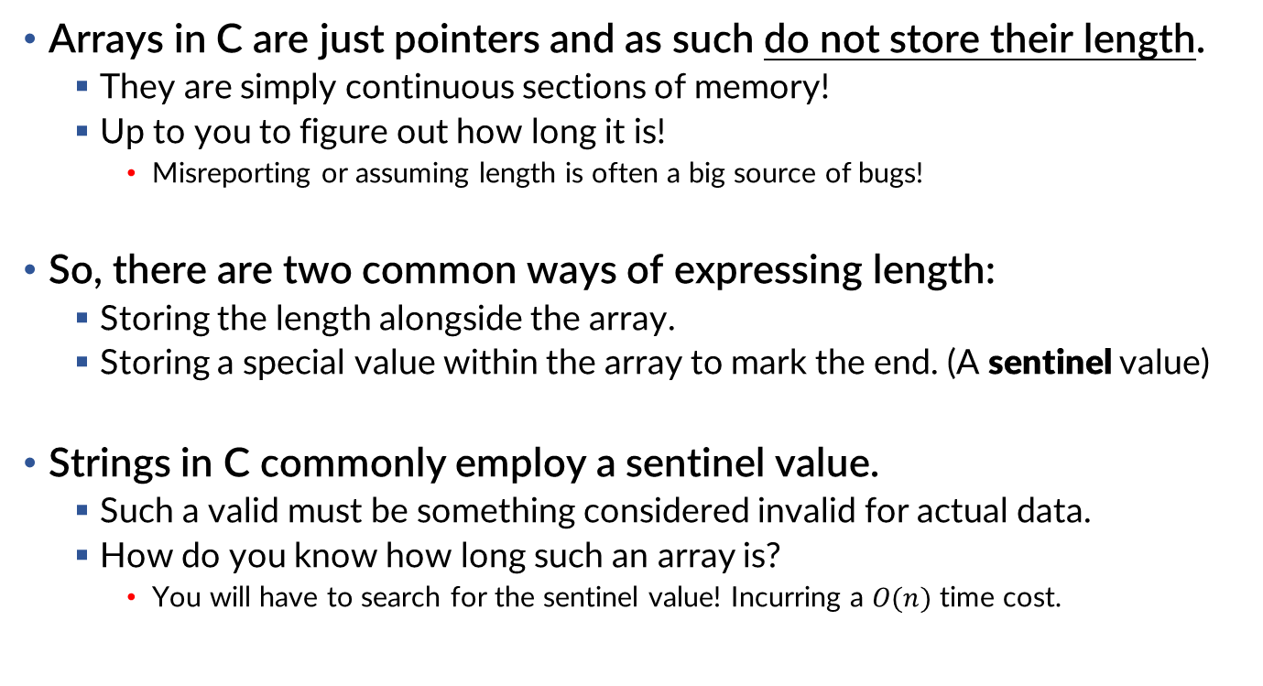
How long is your string?
Arrays in C are just pointers and as such do not store their length.
They are simply continuous sections of memory!
Up to you to figure out how long it is!
Misreporting or assuming length is often a big source of bugs!
So, there are two common ways of expressing length:
Storing the length alongside the array.
Storing a special value within the array to mark the end. (A sentinel value)
Strings in C commonly employ a sentinel value.
Such a valid must be something considered invalid for actual data.
How do you know how long such an array is?
You will have to search for the sentinel value! Incurring a $O(n)$ time cost.

Slide 35
The string literal.
String literals should be familiar from Java.
However, in C, they are char pointers. (That is: char*)
The contents of the literal are read-only (immutable) so it is a: const char*
Modifying it crashes your program!!
A pointer that can’t change pointing to an immutable string is a const char* const
#include <stdio.h> // For 'printf'
void main(void) {
// You could specify it as: char my_string[] = "...";
// But that would allocate the string on the stack!
const char* my_string = "Hello World.";
printf("%s\n", my_string);
}
Let’s ignore this! ☺
(for now)
The variable is allocated on the stack,
which is a pointer. The string itself is
likely in the static data segment!

Slide 36
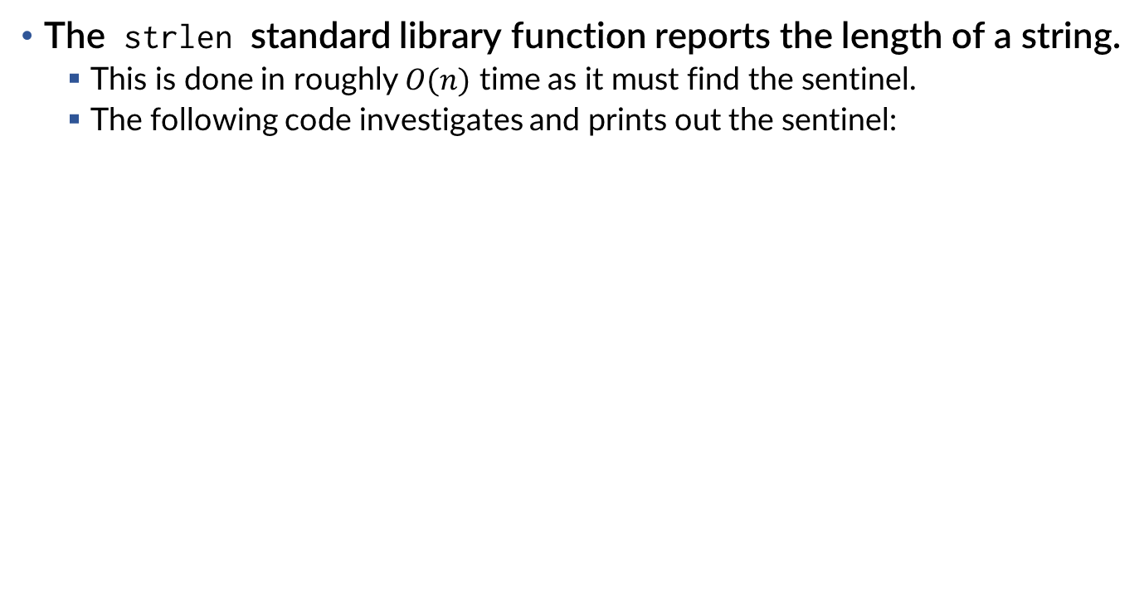
How long is your string? Let’s find out.
The strlen standard library function reports the length of a string.
This is done in roughly $O(n)$ time as it must find the sentinel.
The following code investigates and prints out the sentinel:
#include <stdio.h> // For 'printf'
#include <string.h> // For 'strlen'
void main(void) {
const char* my_string = "Hello World.";
int length = strlen(my_string);
printf("length: %d\n", length);
printf("sentinel: %x\n", my_string[length]);
}

Slide 37
When good strings go bad.
What happens if that sentinel… was not there?
Well… it would keep counting garbage memory until it sees a 0.
#include <stdio.h> // For 'printf'
#include <string.h> // For 'strlen'
void main(void) {
char my_string[] = "Hello World.";
int length = strlen(my_string);
my_string[length] = 42; // Corrupt the sentinel
length = strlen(my_string); // Uh oh.
}
This syntax copies the string literal on to the stack.
This allows us to modify it. (otherwise, it is immutable)
The length here depends on the state of memory in the stack.

Slide 38
Using stronger strings. A… rope… perhaps.
To ensure that malicious input is less likely to be disastrous…
We have alternative standard functions that set a maximum length.
#include <stdio.h> // For 'printf'
#include <string.h> // For 'strnlen'
void main(void) {
char my_string[] = "Hello World.";
int length = strlen(my_string);
my_string[length] = 42; // Corrupt the sentinel
length = strnlen(my_string, 12); // That's fine.
}
strnlen will stop after the 12th character if it does not see a sentinel.

Slide 39
Comparing “Apples” to “Oranges”
When you compare strings using == it compares the addresses!
Since string literals are constant, they only exist in the executable once.
All references will refer to the same string!
#include <stdio.h> // For 'printf'
#include <string.h> // For 'strncmp'
void main(void) {
char* string1 = "apples";
char* string2 = "apples";
if (string1 == string2) {
printf("same\n"); // This runs!
}
}

Slide 40
Comparing “Apples” to “Oranges”
When the addresses differ, they are not equal.
So, you have to be careful when comparing them.
This is similar to Java when considering == versus String.equals()
#include <stdio.h> // For 'printf'
#include <string.h> // For 'strncmp'
void main(void) {
char string1[] = "apples";
char string2[] = "apples";
if (string1 == string2) {
printf("same\n"); // This does not run!
}
}

Slide 41
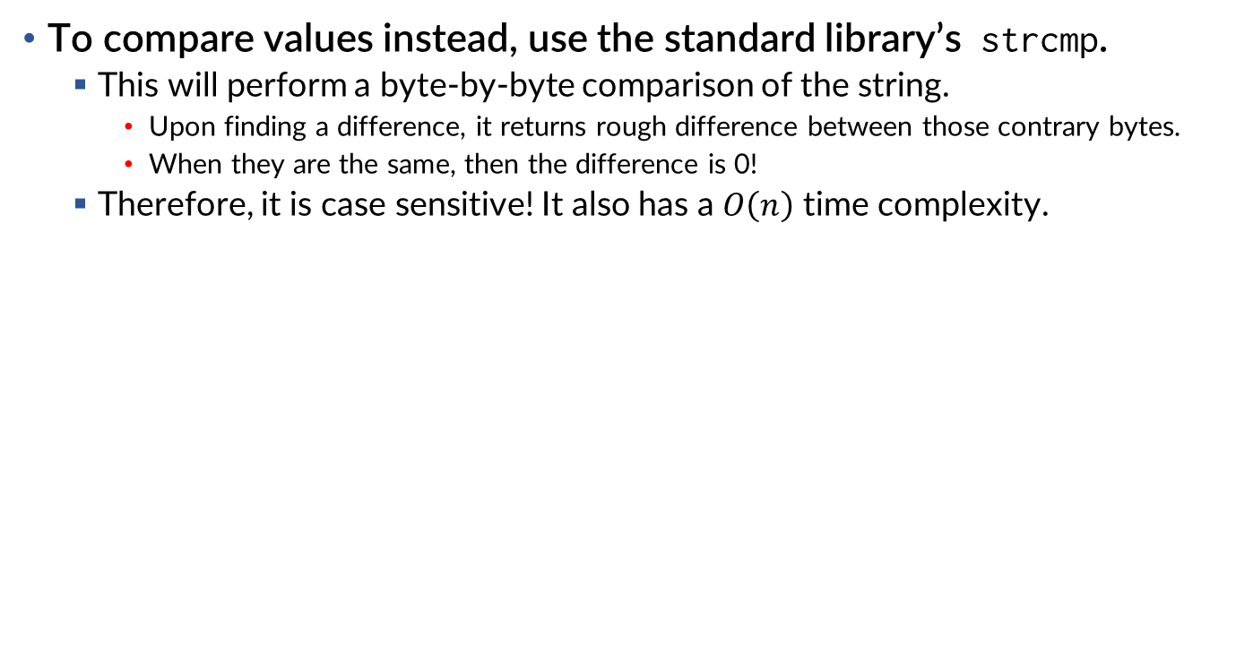
Comparing “Apples” to “Oranges”
To compare values instead, use the standard library’s strcmp.
This will perform a byte-by-byte comparison of the string.
Upon finding a difference, it returns rough difference between those contrary bytes.
When they are the same, then the difference is 0!
Therefore, it is case sensitive! It also has a $O\left(n\right)$ time complexity.
#include <stdio.h> // For 'printf'
#include <string.h> // For 'strncmp'
void main(void) {
char* string1 = "apples";
char* string2 = "apples";
if (strcmp(string1, string2) == 0) {
printf("same\n"); // This runs!
}
} // You could write it as: if(!strcmp(string1, string2))
strcmp will return 0 when the strings
are equal.

Slide 42
Appropriate string construction. A-rope-riate.
#include <stdio.h> // For 'printf' and 'scanf'
#include <string.h> // For 'strnlen' etc
#include <stdlib.h> // For 'calloc' and 'free’
#define MAX_STRING 100
void main(void) {
const char* str_start = "Hello, ";
const char* str_end = "!";
char* str_name = calloc(MAX_STRING + 1, sizeof(char));
char* my_buffer = calloc(MAX_STRING + 1, sizeof(char));
printf("Type in your name: "); // Let someone type in their name
scanf("%100s", str_name); // The term %100s has it record at most 100 characters to str_name.
strncpy(my_buffer, str_start, MAX_STRING);
strncat(my_buffer, str_name, MAX_STRING);
strncat(my_buffer, str_end, MAX_STRING);
printf("%s\n", my_buffer);
free(str_name);
free(my_buffer);
} // Prints "Hello, wilkie!" depending on what you’ve typed in.
C is a very deliberate language.
calloc is important here! Ensures string has
a length of 0. (is initially empty, not garbage!)
Like a ballroom. Empty, but spacious.
strncpy is the bounded form of strcpy.
Overwrites string.
strncat is the bounded form of strcat.
Concatenates to end of existing string.

Slide 43
Memory/Strings: Summary
Memory Allocation
#include <stdlib.h>
malloc(size_t length) Returns pointer to length bytes
calloc(size_t count, size_t size) Returns pointer to (count*size) bytes, zeros them
free(void* ptr) Deallocates memory at ‘ptr’ so it can be allocated elsewhere
Strings
#include <string.h>
strcpy(char* dst, const char* src) Copies src to dst overwriting dst.
strncpy(char* dst, const char* src, size_t max) Copies up to ‘max’ to dst.
strcat(char* dst, const char* src) Copies string from src to end of dst.
strncat(char* dst, const char* src, size_t max) Copies up to ‘max’ to end of dst.
strcmp(const char* a, const char* b) Returns difference between strings. (0 if equal)
strncmp(const char* a, const char* b, size_t max) Compares up to ‘max’ bytes.
Generally safer to use the bounded forms.

Slide 44
Input/Output: Summary
Input
#include <stdio.h>
scanf("%s", my_buffer) Copies string input by user into buffer (unsafe!)
scanf("%10s", my_buffer) Copies up to 10 chars into buffer (my_buffer needs to be >= 11 bytes for sentinel)
scanf("%d", &my_int) Interprets input and places value into int variable.
Output
#include <stdio.h>
printf("%s", my_buffer) Prints string. (technically unsafe)
printf("%10s", my_buffer) Prints up to 10 chars from string. (safe as long as my_buffer is >= 10 bytes)
printf("%d", my_int) Prints int variable. (d for decimal, unfortunately)
printf("%x", my_int) Prints int variable in hexadecimal. (x for hex)
printf("%l", my_int) Prints long variable.
printf("%ul", my_int) Prints unsigned long variable.
Lots more variations! Generally scanf and printf share terms. Look them up!
scanf updates your variable, so you need to pass the address.
(my_buffer does not need it. Strings are already char*)

Slide 45
Structures
It may not have class, but it has style.

Slide 46
Quick note on allocated structures…
You are gonna allocate a lot of structures…
They are big… you want them around… therefore, not good on the stack.
You could make them globals… except when you want them dynamically.
#include <stdlib.h> // For 'calloc'
struct Song {
int lengthInSeconds;
int yearRecorded;
};
void main(void) {
struct Song* p_song = calloc(1, sizeof(struct Song));
(*p_song).lengthInSeconds = 248;
(*p_song).yearRecorded = 2011;
free(p_song); // Remember to free data when you are done!
}

Slide 47
Pointing to structure fields…
A shorthand for (*p_song).field is p_song->field
The “arrow” syntax works only on struct pointers and dereferences a field.
#include <stdlib.h> // For 'calloc'
struct Song {
int lengthInSeconds;
int yearRecorded;
};
void main(void) {
struct Song* p_song = calloc(1, sizeof(struct Song));
p_song->lengthInSeconds = 248; // Compare with last slide.
p_song->yearRecorded = 2011;
free(p_song); // Remember to free data when you are done!
}

Slide 48
Pointing to structure fields…
Recall that typedef is what names types.
If you want a Song data type, you can use typedef to do so:
#include <stdlib.h> // For 'calloc'
typedef struct _Song {
int lengthInSeconds;
int yearRecorded;
} Song;
void main(void) {
Song* p_song = calloc(1, sizeof(Song)); // Compare with last slide.
p_song->lengthInSeconds = 248;
p_song->yearRecorded = 2011;
free(p_song); // Remember to free data when you are done!
}

Slide 49
It took humanity thousands of years to discover the NULL pointer error.
So, what do we use to denote that we are not pointing to anything?
Same as Java… we use a Null value and we hope nobody dereferences it.
It is not a built-in thing! We have to include stddef.h to use it.
#include <stdlib.h> // For 'free'
#include <stddef.h> // For 'NULL'
typedef struct _Song {
int lengthInSeconds;
int yearRecorded;
} Song;
void main(void) {
Song* p_song = NULL;
p_song->lengthInSeconds = 248; // Uh oh.
free(p_song); // Can’t free nothing...
}
// Segmentation fault (core dumped)

Slide 50
When malloc … goes bad
When your request for memory cannot be made, malloc returns NULL!
In your perfect program, you would always check for this.
#include <stdlib.h> // For 'calloc'
#include <stdio.h> // For 'printf'
#include <stddef.h> // For 'NULL'
typedef struct _Song {
int lengthInSeconds;
int yearRecorded;
} Song;
void main(void) {
Song* p_song = malloc(sizeof(Song));
if (p_song == NULL) {
printf("cannot allocate memory!\n");
}
}

Slide 51
When malloc … goes bad
You can check if ptr is null with if(!ptr)
You might say, “hey! NULL is not defined as 0 by the C standard!”
Yet, C specifically considers any pointer equal to NULL to be a false value.
Regardless of the value of NULL which is usually (void*)0 anyway.
#include <stdlib.h> // For 'calloc'
#include <stdio.h> // For 'printf'
#include <stddef.h> // For 'NULL'
typedef struct _Song {
int lengthInSeconds;
int yearRecorded;
} Song;
void main(void) {
Song* p_song = malloc(sizeof(Song));
if (!p_song) { // Alternative (works with modern C just fine)
printf("cannot allocate memory!\n");
}
}

Slide 52
Examples
Some nice examples that address addressing!

Slide 53
Summing it all up.
#include <stdio.h> // For 'printf' and 'scanf'
#include <stdlib.h> // For 'calloc' and 'free'
void main(void) {
int sum = 0;
int* my_array = calloc(5, sizeof(int));
for (int i = 0; i < 5; i++) {
printf("Enter a number: ");
scanf("%d", &my_array[i]);
}
for (int i = 0; i < 5; i++) {
sum += my_array[i];
}
free(my_array);
printf("The sum of all numbers is: %d\n", sum);
}

Slide 54
Searching for values
#include <stdio.h> // For 'printf' and 'scanf'
#include <stdlib.h> // For 'calloc' and 'free'
#include <limits.h> // For INT_MIN and INT_MAX
void main(void) {
int min = INT_MAX, max = INT_MIN;
int* my_array = calloc(5, sizeof(int));
for (int i = 0; i < 5; i++) {
printf("Enter a number: ");
scanf("%d", &my_array[i]);
}
for (int i = 0; i < 5; i++) {
if (my_array[i] < min) {
min = my_array[i];
}
if (my_array[i] > max) {
max = my_array[i];
}
}
free(my_array);
printf("The min is: %d and max is: %d\n", min, max);
}
Remember that scanf wants pointers to data.

Slide 55
Paving a new path
#include <stdio.h> // For 'printf' and 'scanf'
#include <string.h> // For string routines
#include <stdlib.h> // For 'calloc' and 'free'
void main(void) {
char* my_input = calloc(21, sizeof(char));
char* my_path = calloc(106, sizeof(char));
strcpy(my_path, "/");
for (int i = 0; i < 5; i++) {
printf("Enter a directory name: ");
scanf("%20s", my_input);
strcat(my_path, my_input);
strcat(my_path, "/");
}
free(my_input);
// Remove tailing slash!
my_path[strlen(my_path) - 1] = '\0';
printf("The path you have built is: %s\n", my_path);
free(my_path);
}
Remember that scanf wants pointers to data.
When it sees more than 20 characters… what will it do? (What will the next call to scanf do?)

Slide 56
Paving a new path (arbitrary number of directories!)
#include <stdio.h> // For 'printf' and 'scanf'
#include <string.h> // For string routines
#include <stdlib.h> // For 'calloc’ 'realloc' and 'free'
void main(void) {
int buffer_size = 20;
char* my_input = calloc(21, sizeof(char));
char* my_path = calloc(buffer_size, sizeof(char));
do {
printf("Enter a directory name ('stop' will stop): ");
scanf("%20s", my_input);
if (strlen(my_input) + strlen(my_path) + 1 > buffer_size) {
printf("reallocating buffer!\n");
buffer_size += 20;
my_path = realloc(my_path, buffer_size);
}
if (strcmp(my_input, "stop")) {
strcat(my_path, "/");
strcat(my_path, my_input);
}
} while(strcmp(my_input, "stop"));
free(my_input);
printf("The path you have built is: %s\n", my_path);
free(my_path);
}
realloc will resize the allocated space, copying the old value to a new chunk of memory if necessary.
Look it up on your own!

